Slide 1






Human impact on fish biodiversity of coral reef in the Tropical Pacific
Stephanie D’agata ^{1,2*}, David Mouillot^{2,3}, Michel Kulbicki¹,Peter Cowman³, David Bellwood³, Laurent Vigliola^{1,4}
¹ IRD (Institut de Recherche pour le Développement), UR 227 CoReUs
² ECOSYM, UMR CNRS-UM2 5119, Université Montpellier 2, Montpellier, France
³ School of Marine and Tropical Biology, and Australian Research Council Centre of Excellence for Coral Reef Studies, James Cook University, Townsville, QLD, Australia
⁴ SPC (Secretariat of the Pacific Community), Nouméa, New Caledonia
Notes:
,

Slide 2
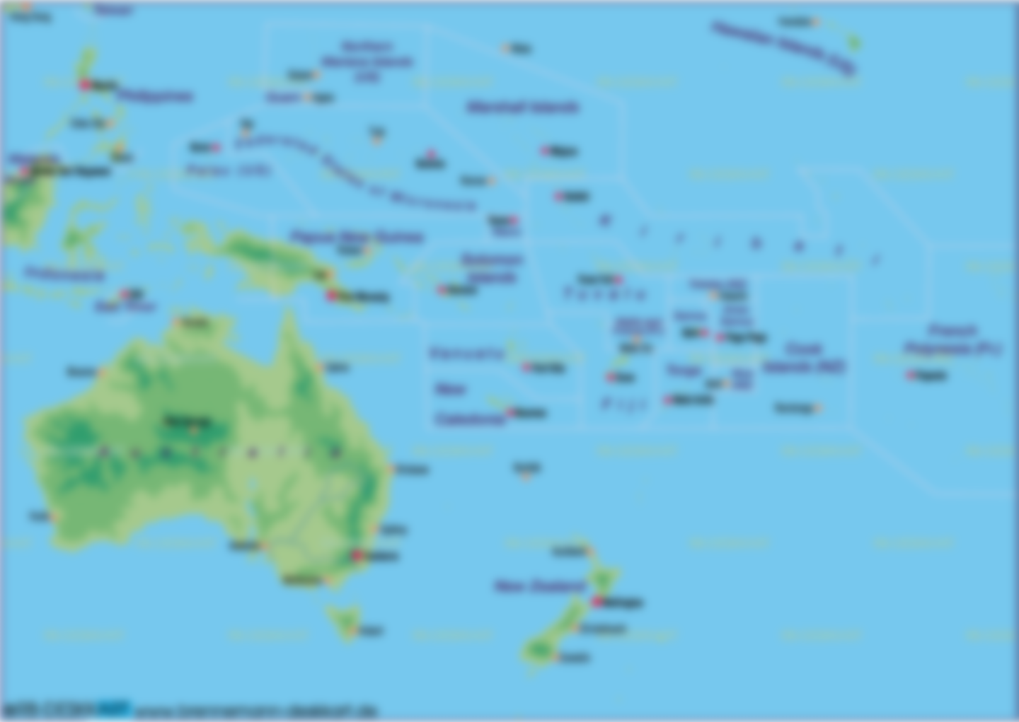

Background
Objective
Hypothesis
Methods
Results/Discussion
Conclusions/Perspectives
Pacific countries: context and issues
Notes:
Insiste plus sur la dépendance de ces populations aux ressources marines.
➔ Changer l’ordre

Slide 3
Background
Objective
Hypothesis
Methods
Results/Discussion
Conclusions/Perspectives
Pacific countries: context and issues
Small Islands Developing States:
small population, limited ressources, remoteness, vulnerability to natural disasters, dependance on international trade, etc.
High dependence on natural ressources
(fisheries, agriculture, tourism, forestry)
Notes:
Insiste plus sur la dépendance de ces populations aux ressources marines.
➔ Changer l’ordre

Slide 4
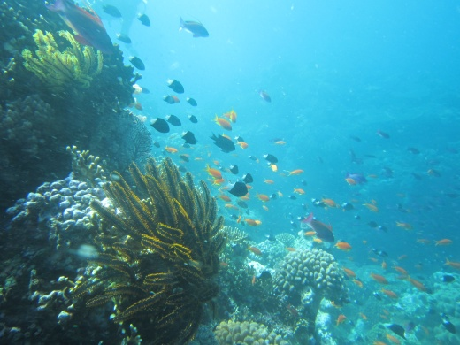
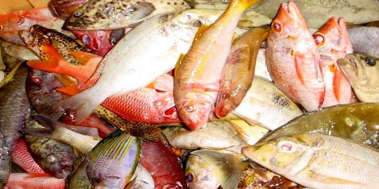
Background
Objective
Hypothesis
Methods
Results/Discussion
Conclusions/Perspectives
Pacific countries: context and issues
Small Islands Developing States:
small population, limited ressources, remoteness, vulnerability to natural disasters, dependance on international trade, etc.
High dependence on natural ressources
(fisheries, agriculture, tourism, forestry)
Fisheries ressources: 80% of islanders in coastal zone
➔ High demand for coral reef fish and invertebrates
➔ Crucial for sustainable economic growth
Notes:
Insiste plus sur la dépendance de ces populations aux ressources marines.
➔ Changer l’ordre

Slide 5
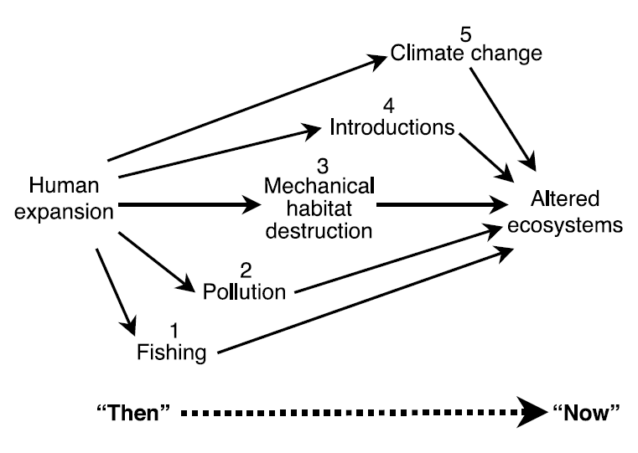

Background
Objective
Hypothesis
Methods
Results/Discussion
Conclusions/Perspectives
Coral reef ecosystems and their biodiversity under numerous threats
Notes:
Insiste plus sur la dépendance de ces populations aux ressources marines.
➔ Changer l’ordre

Slide 6
Background
Objective
Hypothesis
Methods
Results/Discussion
Conclusions/Perspectives
Coral reef ecosystems and their biodiversity under numerous threats
Need for appropriate conservation actions
Notes:
Insiste plus sur la dépendance de ces populations aux ressources marines.
➔ Changer l’ordre

Slide 7
Background
Objective
Hypothesis
Methods
Results/Discussion
Conclusions/Perspectives
Coral reef ecosystems and their biodiversity under numerous threats
Need for appropriate conservation actions
  Need to assess the relative influence of natural and anthropogenic drivers on ecosystem functioning
Notes:
Insiste plus sur la dépendance de ces populations aux ressources marines.
➔ Changer l’ordre

Slide 8
Background
Objective
Hypothesis
Methods
Results/Discussion
Conclusions/Perspectives
Factors influencing ecosystem functioning
Community structure
Species Richness
Diversity of traits/lineages
(Functional and Phylogenetic diversity)

Slide 9
Background
Objective
Hypothesis
Methods
Results/Discussion
Conclusions/Perspectives
Factors influencing ecosystem functioning
Community structure
Species Richness
Ecosystem functioning
Diversity of traits/lineages
(Functional and Phylogenetic diversity)

Slide 10
Background
Objective
Hypothesis
Methods
Results/Discussion
Conclusions/Perspectives
Factors influencing ecosystem functioning
Community structure
Species Richness
Ecosystem functioning
Diversity of traits/lineages
(Functional and Phylogenetic diversity)

Slide 11
Background
Objective
Hypothesis
Methods
Results/Discussion
Conclusions/Perspectives
Factors influencing ecosystem functioning
Community structure
Species Richness
Ecosystem functioning
Diversity of traits/lineages
(Functional and Phylogenetic diversity)

Slide 12
Background
Objective
Hypothesis
Methods
Results/Discussion
Conclusions/Perspectives
Factors influencing ecosystem functioning
Natural environnemental factors
Community structure
Species Richness
Ecosystem functioning
Diversity of traits/lineages
(Functional and Phylogenetic diversity)
Anthropogenic factors

Slide 13
Background
Objective
Hypothesis
Methods
Results/Discussion
Conclusions/Perspectives
Factors influencing ecosystem functioning
Natural environnemental factors
Biogeography
Habitat
Community structure
Species Richness
Ecosystem functioning
Diversity of traits/lineages
(Functional and Phylogenetic diversity)
Socio-economy
Anthropogenic factors

Slide 14
Background
Objective
Hypothesis
Methods
Results/Discussion
Conclusions/Perspectives
Factors influencing ecosystem functioning
Natural environnemental factors
Enterlaced effects
Magnitude of each factor dependent on the scale of investigation
Biogeography
Habitat
Species Richness
Ecosystem functioning
Species composition:
Ensemble of traits/lineages
(Functional and Phylogenetic diversity)
Socio-economy
Anthropogenic factors

Slide 15
Background
Objective
Hypothesis
Methods
Results/Discussion
Conclusions/Perspectives
Factors influencing ecosystem functioning
Natural environnemental factors
Enterlaced effects
Magnitude of each factor dependent on the scale of investigation
Disentangling the natural and anthropogenic factors influencing the 3 biodiversity components of reef fish communities at a large geographical scale
Biogeography
Habitat
Species Richness
Objective
Ecosystem functioning
Species composition:
Ensemble of traits/lineages
(Functional and Phylogenetic diversity)
Socio-economy
Anthropogenic factors

Slide 16
Background
Objective
Hypothesis
Methods
Results/Discussion
Conclusions/Perspectives
Main hypothesis: human pressure on functional and phylogenetic diversity
A
B
C
D
E
F
G
- H₀ = Random hypothesis
Species are catched independently of their traits (or lineages)

Slide 17
Background
Objective
Hypothesis
Methods
Results/Discussion
Conclusions/Perspectives
Main hypothesis: human pressure on functional and phylogenetic diversity
A
B
C
D
E
F
G
A
B
C
D
E
F
G
- H₀ = Random hypothesis
Species are catched independently of their traits (or lineages)
- H₁ = Non random hypothesis (e.g. Thuillier et al. 2011; Purvis et al., 2000)
➔ Species are catched regarding special traits (or lineages)

Slide 18
Background
Objective
Hypothesis
Methods
Results/Discussion
Conclusions/Perspectives
Main hypothesis: human pressure on functional and phylogenetic diversity
Erosion H₀ < Erosion H₁
A
B
C
D
E
F
G
A
B
C
D
E
F
G
- H₀ = Random hypothesis
Species are catched independently of their traits (or lineages)
- H₁ = Non random hypothesis (e.g. Thuillier et al. 2011; Purvis et al., 2000)
➔ Species are catched regarding special traits (or lineages)

Slide 19
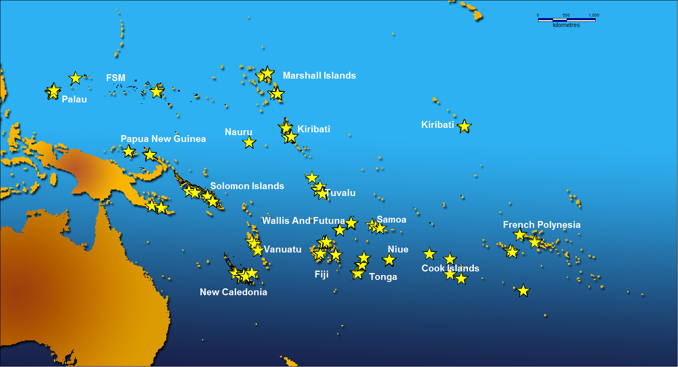


Background
Objective
Hypothesis
Methods
Results/Discussion
Conclusions/Perspectives
17 countries, 63 villages, 1553 transects (dive transects)
(2002 – 2009)

Slide 20
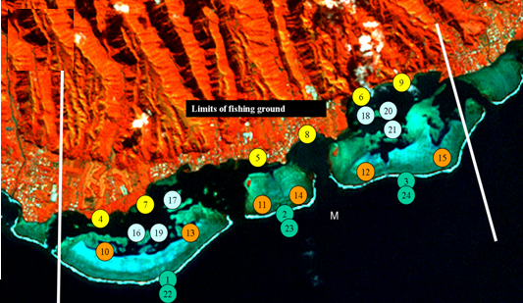
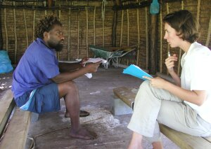
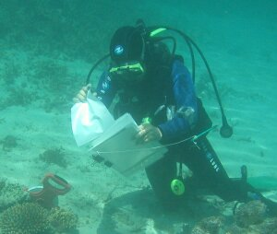
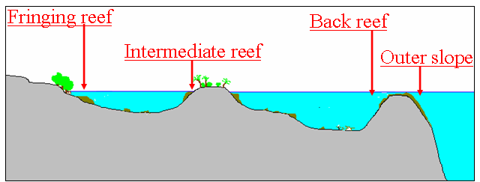
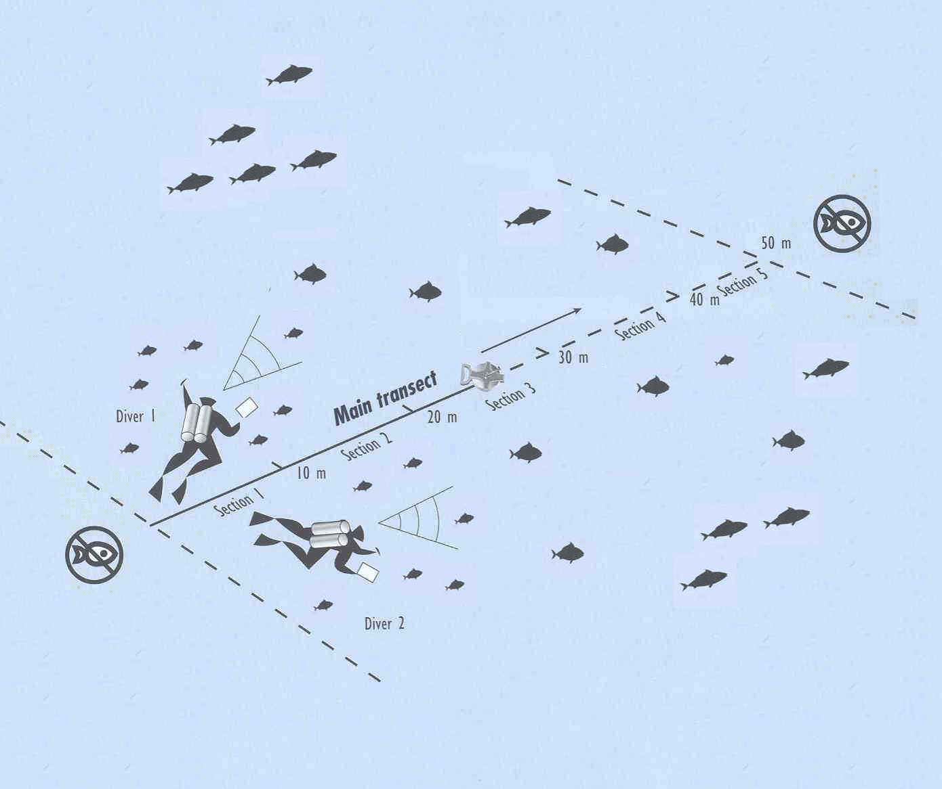
Background
Objective
Hypothesis
Methods
Results/Discussion
Conclusions/Perspectives
Sampling design
Populations, fish catch
Fishing techniques, etc.
Fish communities
Substrat

Slide 21
Background
Objective
Hypothesis
Methods
Results/Discussion
Conclusions/Perspectives
Sampling design
Populations, fish catch
Fishing techniques, etc.
Fish communities
Substrat
➔ A gradient of human pressure associated with fish community structures

Slide 22
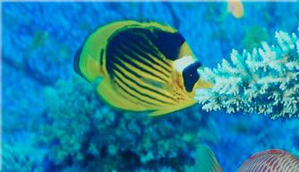
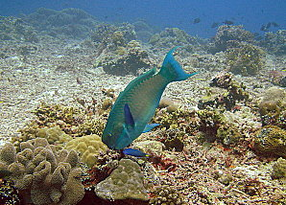
Background
Objective
Hypothesis
Methods
Results/Discussion
Conclusions/Perspectives
Data analysis
Focus on 2 contrasted families
Chaetodontidae
Butterfly fish
Scaridae
Parrotfish
NON-EXPLOITED
EXPLOITED
Functional traits (6): Maximum size, Diet, Home-range, Activity, Schooling, Level (M. Kulbiki)
Phylogenetic trees: Cowman & Bellwood 2011 (J.Evol. Biol)

Slide 23
Background
Objective
Hypothesis
Methods
Results/Discussion
Conclusions/Perspectives
Data analysis
~ 65 « socio-economic » variables
- demography
- economic (GDP, HDI)
- salaries, market distance
- fishing techniques, catch
- etc.
~ 29« Habitat » variables
Type of reef
Depth, Habitability
% coral cover
etc.
~ 15 « Biogeographic » variables
- Latitude, longitude
- Distance to biodiversity hotspot
- Type of island, size of the island
- Connectivity variables

Slide 24
Background
Objective
Hypothesis
Methods
Results/Discussion
Conclusions/Perspectives
Data analysis
~ 65 « socio-economic » variables
- demography
- economic (GDP, HDI)
- salaries, market distance
- fishing techniques, catch
- etc.
~ 29« Habitat » variables
Type of reef
Depth, Habitability
% coral cover
etc.
~ 15 « Biogeographic » variables
- Latitude, longitude
- Distance to biodiversity hotspot
- Type of island, size of the island
- Connectivity variables
Socio-Economic PCOA
Habitat PCOA
Biogeography PCOA
5 first axes
5 first axes
5 first axes

Slide 25
Background
Objective
Hypothesis
Methods
Results/Discussion
Conclusions/Perspectives
Data analysis
~ 65 « socio-economic » variables
- demography
- economic (GDP, HDI)
- salaries, market distance
- fishing techniques, catch
- etc.
~ 29« Habitat » variables
Type of reef
Depth, Habitability
% coral cover
etc.
~ 15 « Biogeographic » variables
- Latitude, longitude
- Distance to biodiversity hotspot
- Type of island, size of the island
- Connectivity variables
Socio-Economic PCOA
Habitat PCOA
Biogeography PCOA
5 first axes
5 first axes
5 first axes
Used to model:
Species richness (S), Weighted Functional diversity (FD_{w}), Weighted Phylogenetic diversity (PD_{w})
of Chaetodontidae and Scaridae with Boosted RegressionTrees (BRTs)
Independence between variables, Same weight given to each class, No a priori on the raw variables

Slide 26

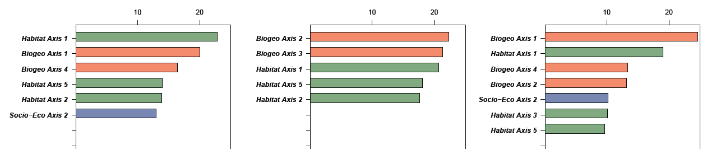
Background
Objective
Hypothesis
Methods
Results/Discussion
Conclusions/Perspectives
Chaetodontidae
Species Richness
Weighted Functional Diversity (FD_{w})
Weighted Phylogenetic Diversity (PD_{w})
%
%
%
Predominance of biogeographic and habitat variables on all 3 biodiversity components
➔ Chaetodontidae an appropriate control family to assess human impact
Biogeography
Habitat
Socio-economy

Slide 27
Background
Objective
Hypothesis
Methods
Results/Discussion
Conclusions/Perspectives
Chaetodontidae
Species Richness
Weighted Functional Diversity (FD_{w})
Weighted Phylogenetic Diversity (PD_{w})
%
%
%
Predominance of biogeographic and habitat variables on all 3 biodiversity components
➔ Chaetodontidae an appropriate control family to assess human impact
Biogeography
Habitat
Socio-economy

Slide 28

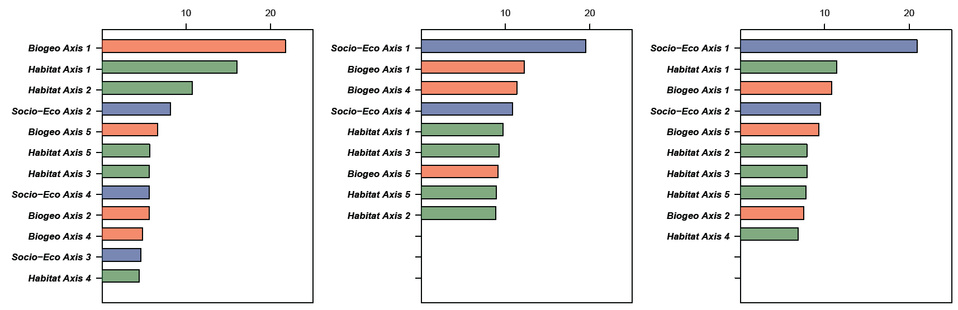
Background
Objective
Hypothesis
Methods
Results/Discussion
Conclusions/Perspectives
Scaridae
Species Richness
Weighted Functional Diversity (FD_{w})
Weighted Phylogenetic Diversity (PD_{w})
%
%
%
Biogeography
Habitat
Socio-economy

Slide 29
Background
Objective
Hypothesis
Methods
Results/Discussion
Conclusions/Perspectives
Scaridae
Species Richness
Weighted Functional Diversity (FD_{w})
Weighted Phylogenetic Diversity (PD_{w})
%
%
%
Socio-Economy
Habitat/Biogeography
- Predominance of Socio-Economy on Functional and Phylogenetic Diversity
Biogeography
Habitat
Socio-economy

Slide 30
Background
Objective
Hypothesis
Methods
Results/Discussion
Conclusions/Perspectives
Scaridae
Species Richness
Weighted Functional Diversity (FD_{w})
Weighted Phylogenetic Diversity (PD_{w})
%
%
%
Socio-Economy
Habitat/Biogeography
- Predominance of Socio-Economy on Functional and Phylogenetic Diversity
Biogeography
Habitat
Socio-economy

Slide 31
Background
Objective
Hypothesis
Methods
Results/Discussion
Conclusions/Perspectives
Scaridae
Species Richness
Weighted Functional Diversity (FD_{w})
Weighted Phylogenetic Diversity (PD_{w})
%
%
%
Biogeography
Habitat
Socio-Economy
Habitat/Biogeography
- Predominance of Socio-Economy on Functional and Phylogenetic Diversity
Predominance of Biogeography and Habitat on Species richness
Biogeography
Habitat
Socio-economy

Slide 32
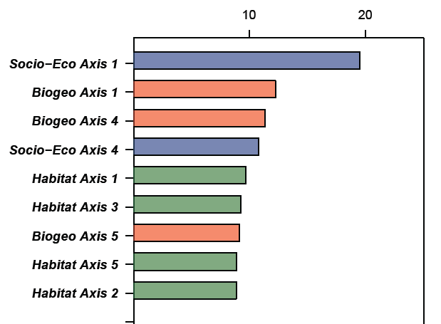
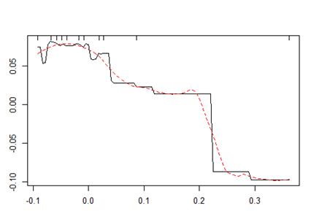
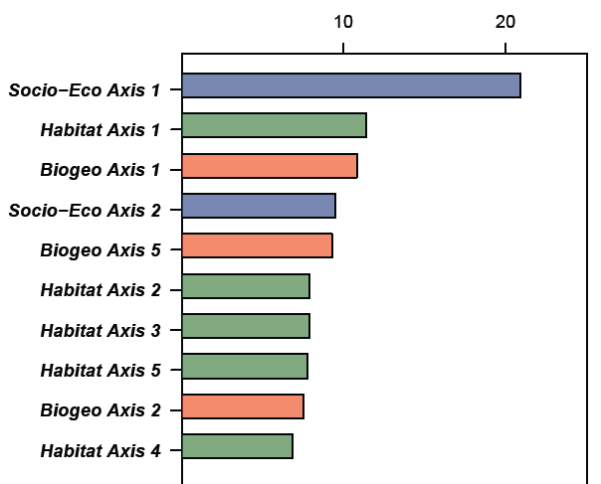
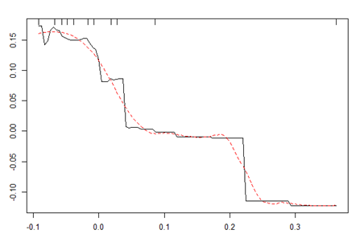
Background
Objective
Hypothesis
Methods
Results/Discussion
Conclusions/Perspectives
Scaridae
Weighted Functional Diversity (FD_{w})
FDw
Weighted Phylogenetic Diversity (PD_{w})
PDw
Socio-Eco Axis 1
Population, fish catch

Slide 33
Background
Objective
Hypothesis
Methods
Results/Discussion
Conclusions/Perspectives
Scaridae
Weighted Functional Diversity (FD_{w})
FDw
Weighted Phylogenetic Diversity (PD_{w})
PDw
Socio-Eco Axis 1
Population, fish catch

Slide 34
Background
Objective
Hypothesis
Methods
Results/Discussion
Conclusions/Perspectives
Conclusions:
Functional and Phylogenetic trees eroded by humans at the Pacific scale : Potential implications for ecosystem functioning and services
(e.g. Hughes et al., 2007 Cur.Biol. ; Graham et al., 2011 Eco.Lett, Bellwood et al. 2011 Proc.Roy. Soc.)
Irrelevance of species richness alone to assess ecosystem health
Important threshold effects
A
B
C
D
E
F
G

Slide 35
Background
Objective
Hypothesis
Methods
Results/Discussion
Conclusions/Perspectives
Conclusions:
Functional and Phylogenetic trees eroded by humans at the Pacific scale : Potential implications for ecosystem functioning and services
(e.g. Hughes et al., 2007 Cur.Biol. ; Graham et al., 2011 Eco.Lett, Bellwood et al. 2011 Proc.Roy. Soc.)
Irrelevance of species richness alone to assess ecosystem health
Important threshold effects
Conservation implications:
Importance to protect all biodiversity components through the establishment of Marine Protected Areas (MPAS) (e.g. Mouillot et al. 2008, 2011)
Determining critical reference points for sustainable management
(McClanahan et al. 2011 PNAS)
A
B
C
D
E
F
G

Slide 36
Background
Objective
Hypothesis
Methods
Results/Discussion
Conclusions/Perspectives
Conclusions:
Functional and Phylogenetic trees eroded by humans at the Pacific scale : Potential implications for ecosystem functioning and services
(e.g. Hughes et al., 2007 Cur.Biol. ; Graham et al., 2011 Eco.Lett, Bellwood et al. 2011 Proc.Roy. Soc.)
Irrelevance of species richness alone to assess ecosystem health
Important threshold effects
Conservation implications:
Importance to protect all biodiversity components through the establishment of Marine Protected Areas (MPAS) (e.g. Mouillot et al. 2008, 2011)
Determining critical reference points for sustainable management
(McClanahan et al. 2011 PNAS)
Perspectives:
Need to assess experimentally the link between functional/phylogenetic diversity and ecosystem functioning in marine ecosystems
Determine baselines for functional and phylogenetic diversity
A
B
C
D
E
F
G

Slide 37
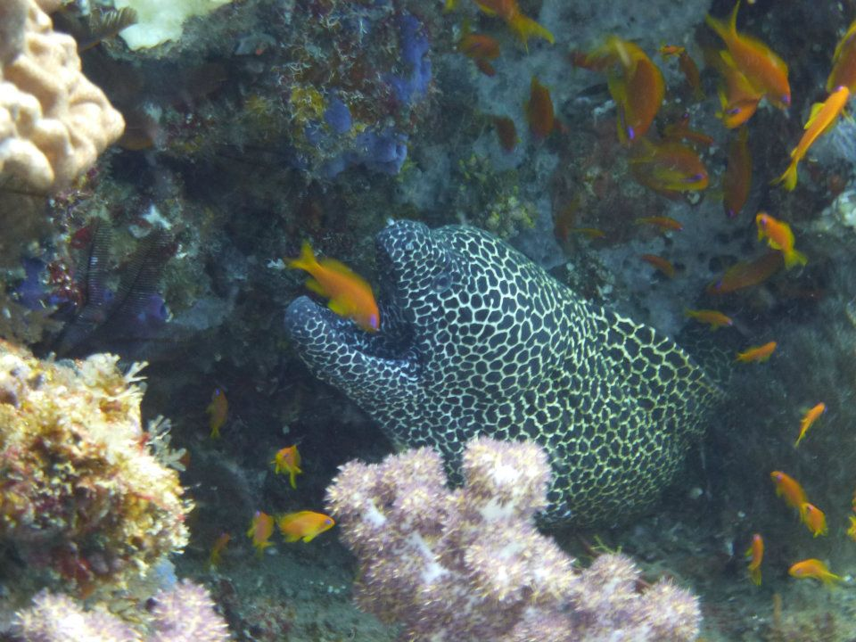
Thanks for your attention
Any questions?
* Corresponding author: stephanie.dagata@gmail.com

Slide 38
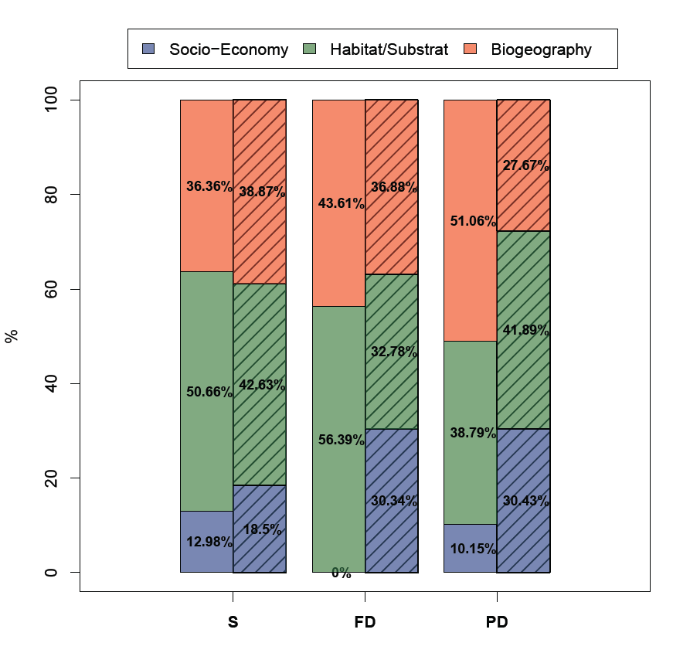
Contributions in % of each class of variables for the 2 families, and for each biodiversity facet

Slide 39
Contributions in % of each class of variables for the 2 families, and for each biodiversity facet

Slide 40
1st problematic: disentanling factors influencing FD and PD
Hypothesis
Erosion H₀ < Erosion H₁
A
B
C
D
E
F
G
A
B
C
D
E
F
G
- H₀ = Random hypothesis
Catch of species is done independently of their traits (ou de leurs lignées)
- H₁ = Non random hypothesis (e.g. Thuillier et al. 2011; Purvis et al., 2000)
➔ Catch of species is done regarding special traits (or lineages)

Slide 41
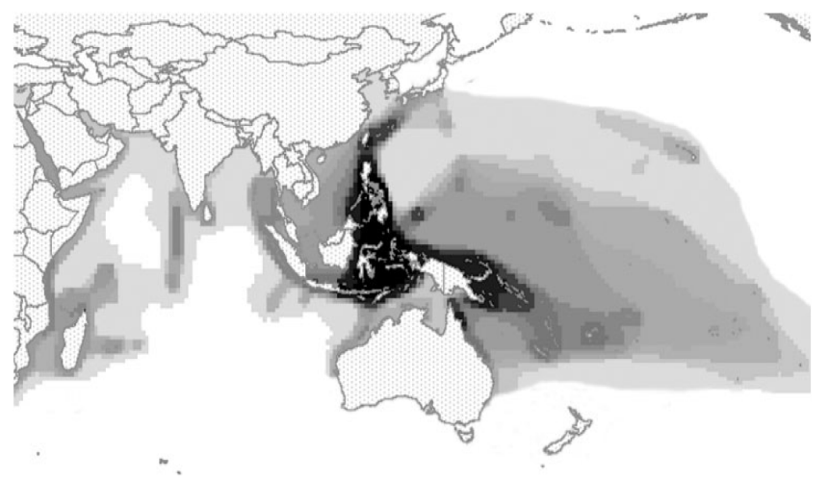
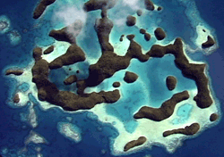
Background
Natural factors: Biogeographic influences
Species richness decreasing gradient around the biodiversity hotspot
(Allen 2008)
Biodiversity increase with connectivity
Photo © S. Summerhays

Slide 42
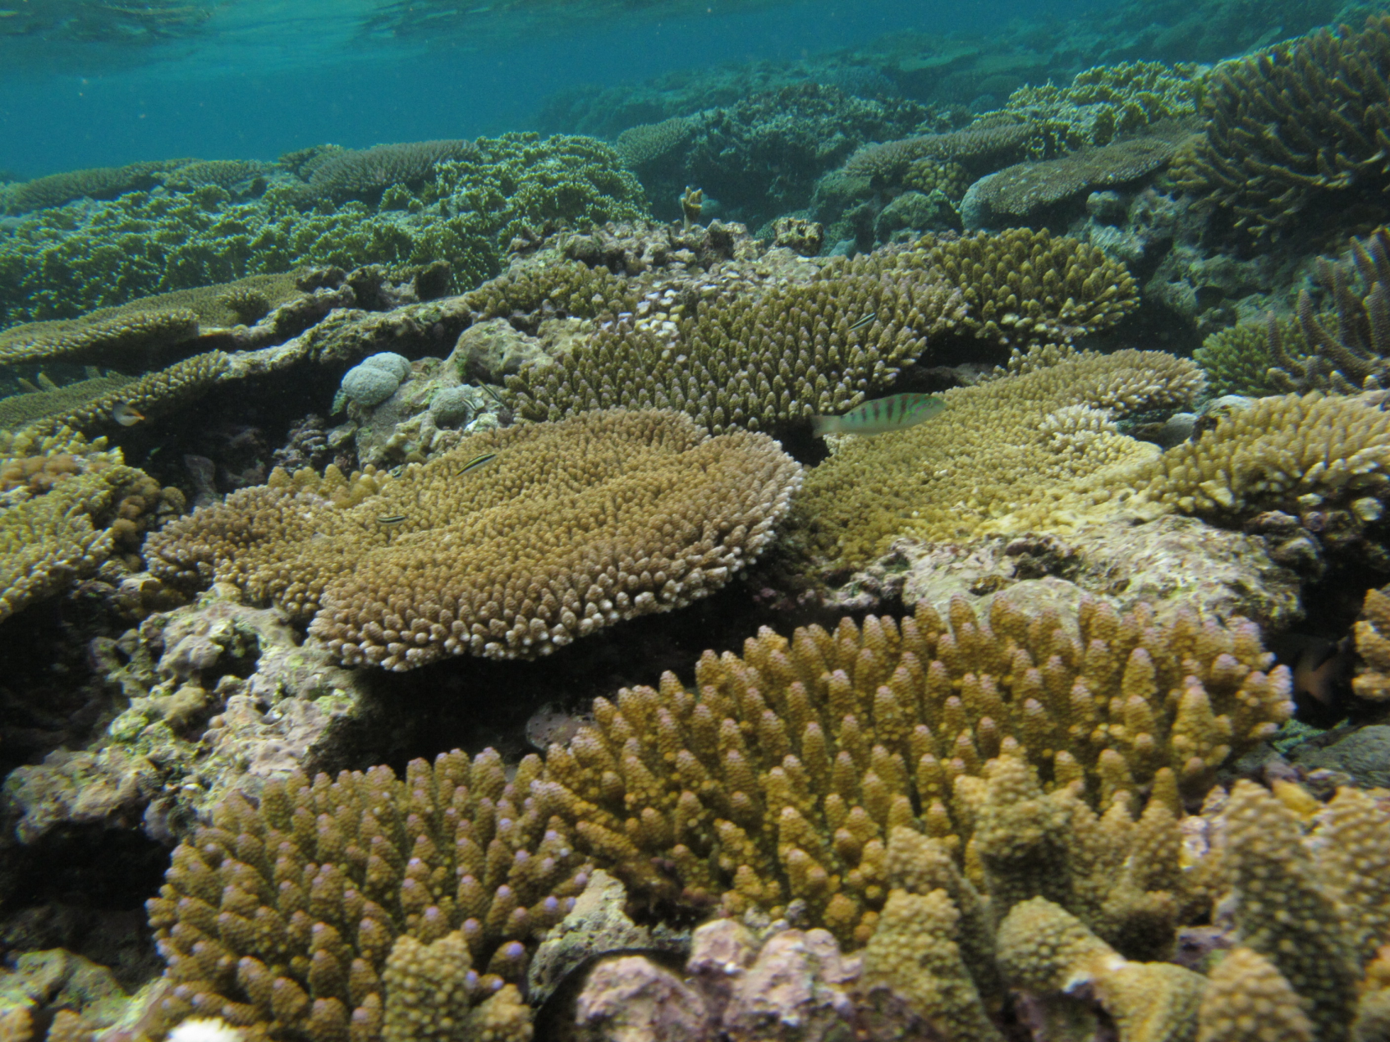
Background
Natural factors: Habitat/substrat influences
Live coral cover (e.g. Friedlander & Parrish 1998; Findley and Findley 2001)
Reef complexity (e.g. Graham et al., 2006; Wilson et al., 2007)

Slide 43
Background
Anthropogenic factors: fishing influences

Slide 44
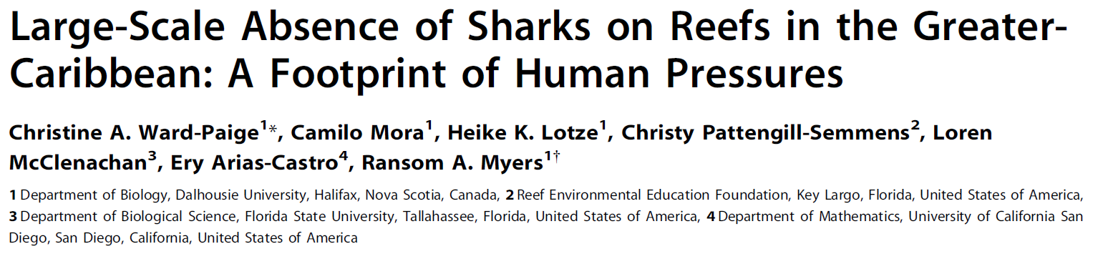
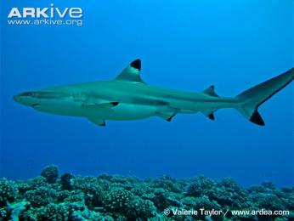
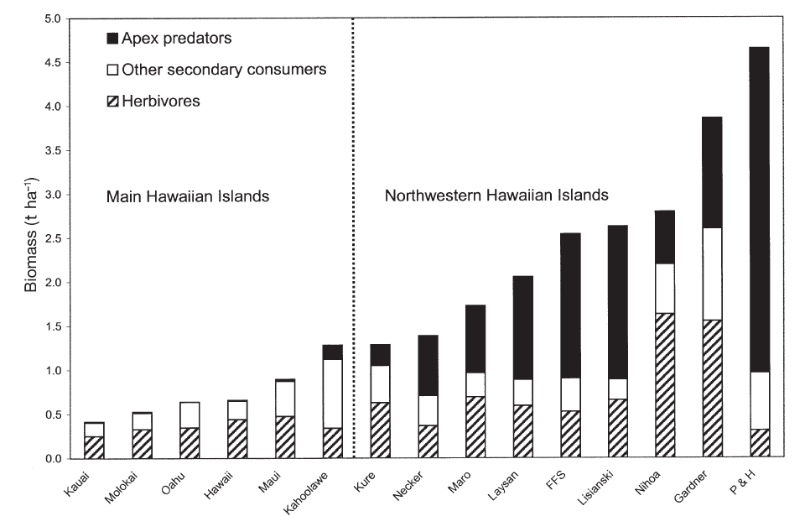
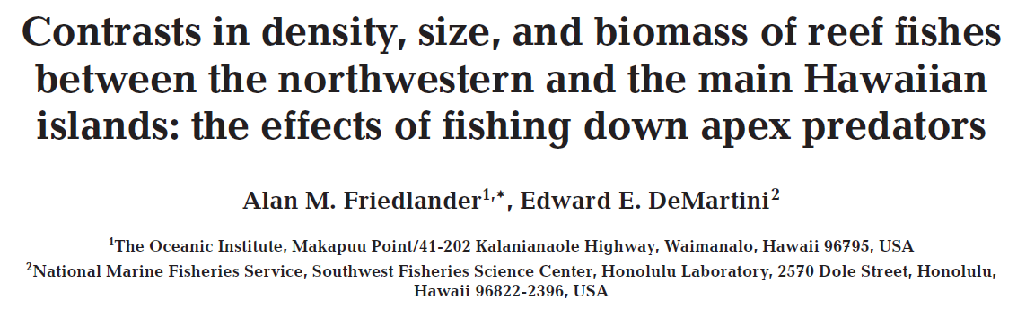
Background
Anthropogenic factors: fishing influences
(2011)
Anthropized islands
Remote islands
(2002)

Slide 45
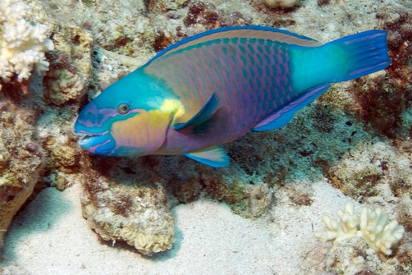

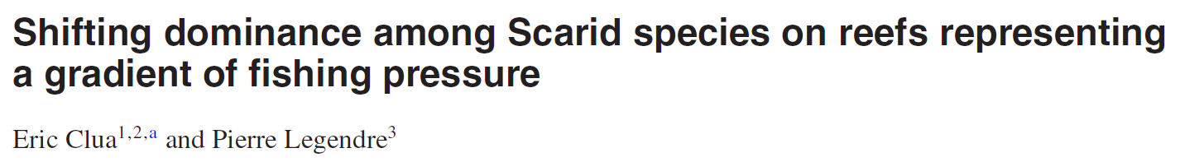
Background
Anthropogenic factors: fishing influences
(2011)
Anthropized islands
Remote islands
(2002)
(2008)

Slide 46
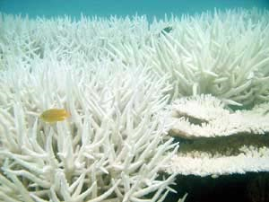
Coral reef ecosystems and their biodiversity: context and issues
An ecosystem under numerous threats :
Overfishing, climate change, pollution, etc. (e.g. Jackson et al., 2001)
➔ Removal of key species: altered functioning

Slide 47
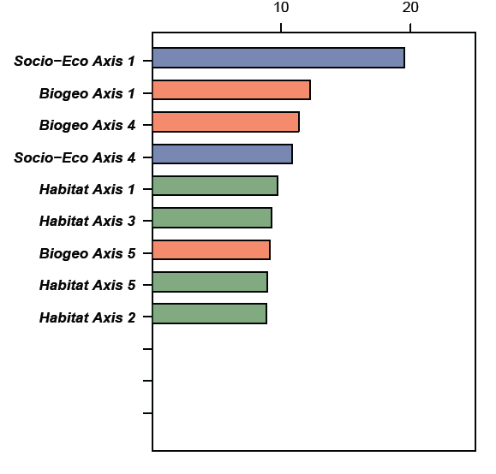
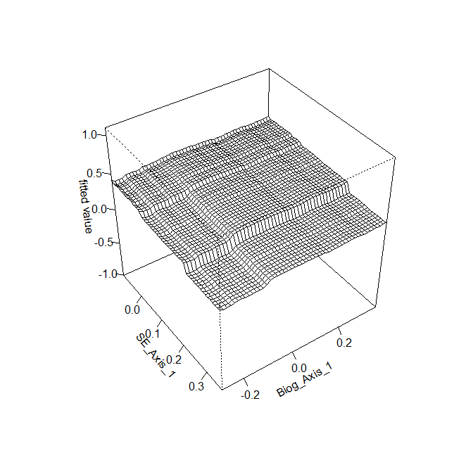
Results/Discussion
Interactions between
FDw
Socio-Eco Axis 1
Biogeography Axis 1
Notes:
Effet de la pêche indépendante de l’éffet des autres variables sur FDw.
Prélèvement des fonctions indépendemment de la distance au centre de biodiv

Slide 48
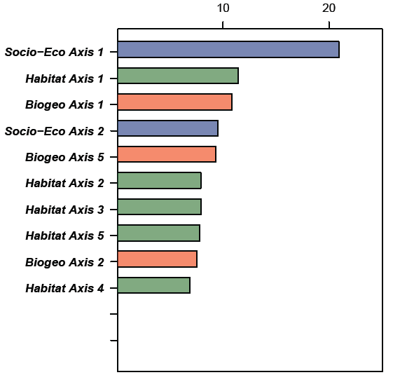
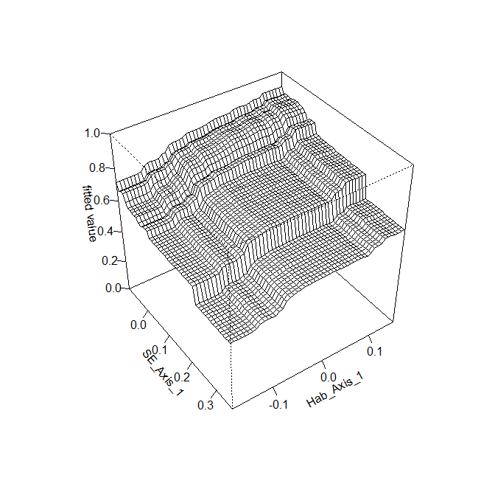
PDw Scaridae
Socio-Eco Axis 1
Habitat Axis 1
PDw Scaridae

Slide 49
Background
Objective
Hypothesis
Methods
Results/Discussion
Conclusions/Perspectives
Factors influencing ecosystem functioning
Structure and community organisation
(taxonomic, functional, genetic (phylo-))
Ecosystem functioning proxies
Species role
Ecosystem functioning
Cardinale et al., 2012 for a review (Nature)

Slide 50
Background
Objective
Hypothesis
Methods
Results/Discussion
Conclusions/Perspectives
Factors influencing ecosystem functioning
Natural environnemental factors
Structure and community organisation
(taxonomic, functional, genetic (phylo-))
Ecosystem functioning proxies
Species role
Ecosystem functioning
Cardinale et al., 2012 for a review (Nature)
Anthropogenic factors

Slide 51
Background
Objective
Hypothesis
Methods
Results/Discussion
Conclusions/Perspectives
Factors influencing ecosystem functioning
Natural environnemental factors
Habitat
Biogeography
Structure and community organisation
(taxonomic, functional, genetic (phylo-))
Ecosystem functioning proxies
Species role
Ecosystem functioning
Cardinale et al., 2012 for a review (Nature)
Socio - Economy
Anthropogenic factors

Slide 52
Background
Objective
Hypothesis
Methods
Results/Discussion
Conclusions/Perspectives
Factors influencing ecosystem functioning
Natural environnemental factors
Enterlaced effects
Magnitude of each factor dependent on the scale of investigation
Disentangling the natural and anthropogenic factors influencing the 3 biodiversity components of reef fish communities at a large geographical scale
Habitat
Biogeography
Structure and communauty organisation
(taxonomic, functional, genetic (phylo-))
Ecosystem functioning proxies
Species role
Ecosystem functioning
Cardinale et al., 2012 for a review (Nature)
Socio - Economy
Anthropogenic factors

